Slide 1
Development of master curricula for natural disasters risk management in Western Balkan countries
Forming of Project Management Committee
Milan Gocić
University of Niš
First Steering Committee meeting/ 05th April 2017
Project number: 573806-EPP-1-2016-1-RS-EPPKA2-CBHE-JP
"This project has been funded with support from the European Commission. This publication reflects the views only of the author, and the Commission cannot be held responsible for any use which may be made of the information contained therein"

Slide 2
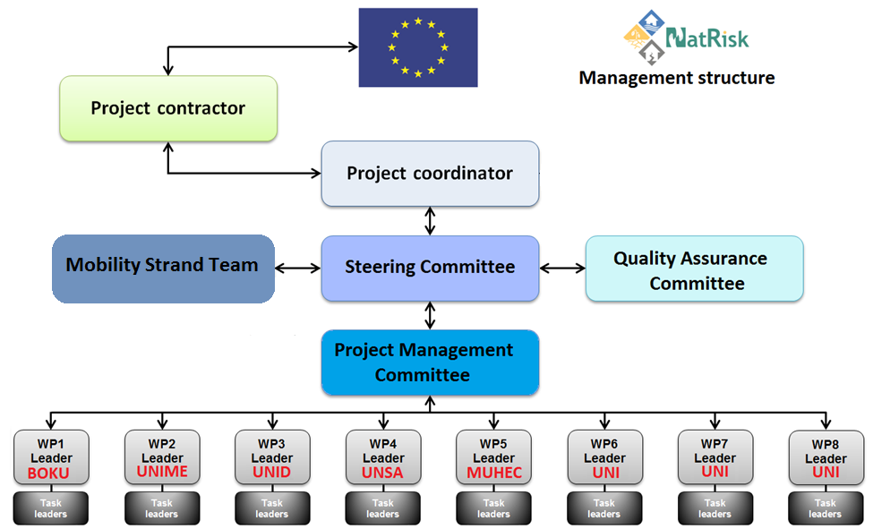
Development of master curricula for natural disasters risk management in Western Balkan countries

Slide 3
Project management structure
Development of master curricula for natural disasters risk management in Western Balkan countries
Project Coordinator (PC) - is responsible for overall project management (technical and operational), communication and reporting to EACEA, efficient use of the project grant, etc.
Steering Committee (SC) - decision-making body consisting of one representative (preferably the contact person) from each partner institution. SC will meet twice a year (in combination with other project events due to cost efficiency) to discuss and review the progress of project activities, make decisions, approve deliverables and agree on any risk contingency measures.

Slide 4
Project management structure
Development of master curricula for natural disasters risk management in Western Balkan countries
Project Management Committee (PMC) - is responsible for the achievement of the project outcomes.
Quality Assurance Committee (QAC) - consisted of 4 members from partner institutions experienced in quality assurance. The QAC team is a direct support to the Project Coordinator in monitoring and assessing the quality of the project and its results, as well as development of Quality Control and Monitoring Plan.
Mobility Strand Team (MST) - is responsible for special mobility strand.

Slide 5
Project management structure
Development of master curricula for natural disasters risk management in Western Balkan countries
WP Leaders (WPL) - responsible for monitoring of the overall progress of the WP and its activities.
Task Leaders (TL) - are in charge of monitoring the assigned activity, ensuring its quality level and timeliness, and active participation of other partners.

Slide 6
NatRisk Management Structure
Development of master curricula for natural disasters risk management in Western Balkan countries
Project Consortium (12 partners) ↔ Contact Persons
Coordinator Institution UNI ↔ Project Coordinator
Steering Committee (SC): one representative from each partner institution, 12
Project Management Committee (PMC): Project Coordinator + 8 WP Coordinators
Work Package Leaders: representatives from UNI, BOKU, MUHEC, UNSA, UNIME, UNID
Quality Assurance Committee: 4 members (UNI, BOKU, MUHEC, OE)
Mobility Strand Team: 5 members (UNI)
Task Leaders: from each institution involved in a particular WP

Slide 7
Replacement in Steering Committee
Development of master curricula for natural disasters risk management in Western Balkan countries
Instead of Prof. Dragana Kolarić (KPA), new member is Prof. Saša Mijalković (KPA).
Ammendment on ANNEX I - Decision on the forming of NatRisk project management bodies

Slide 8
Project Management Committee
Development of master curricula for natural disasters risk management in Western Balkan countries
No. | Acronym | Name
1 | UNI | Assis. Prof. Milan Gocić, Project Coordinator
2 | BOKU | Assoc. Prof. Michael Tritthart, WP1 Leader
3 | UNIME | Prof. Giuseppe Tito Aronica, WP2 Leader
4 | UNID | Prof. Miroslav Talijan, WP3 Leader
5 | UNSA | Assoc. Prof. Emina Hadžić, WP4 Leader
6 | MUHEC | Prof. Sally Priest, WP5 Leader
7 | UNI | Prof. Dejan Rančić, WP6 Leader
8 | UNI | Prof. Slaviša Trajković, WP7 Leader
Ammendment on ANNEX I - Decision on the forming of NatRisk project management bodies

